Slide 1
Chi-Square test for
Goodness of Fit
Prepared by
Sajana Shakya

Slide 2
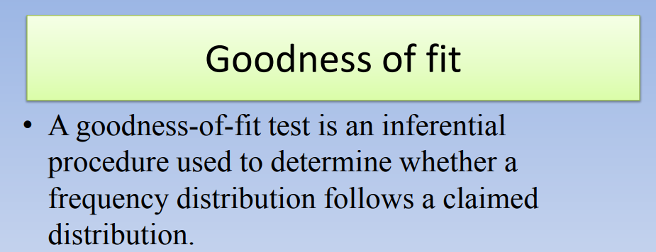

Slide 3
The chi-square test is used to test if a sample of data came from a population with a specific distribution. Chi-Square goodness of fit test determines how well theoretical distribution (such as normal, binomial, or Poisson) fits the empirical distribution.

Slide 4
Example
Fit a Poisson distribution to the following data and test the goodness of fit.
X | 0 | 1 | 2 | 3 | 4
f | 120 | 60 | 15 | 4 | 1

Slide 5
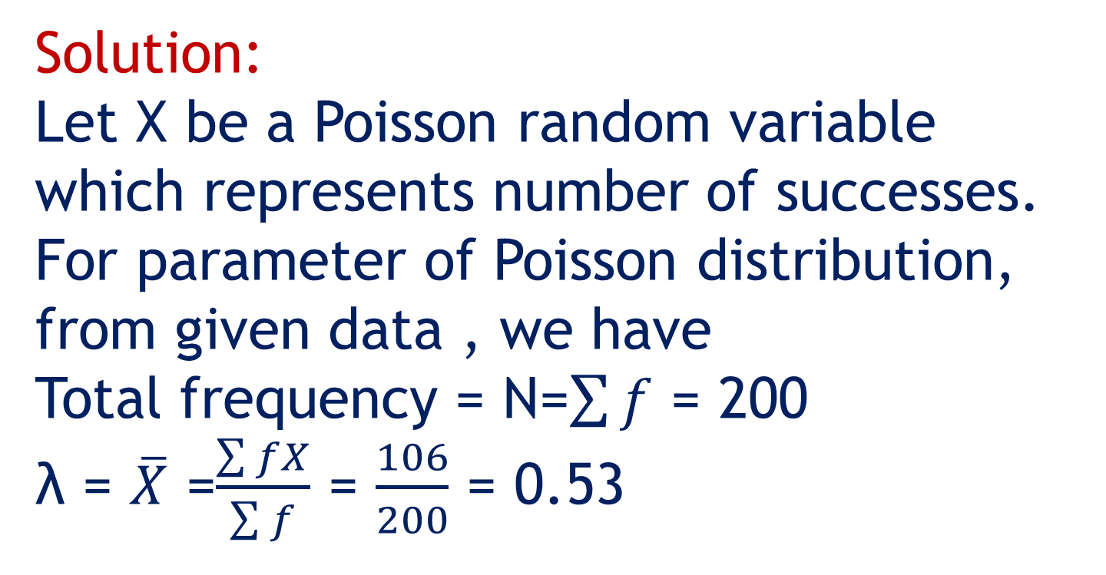
Solution:
Let X be a Poisson random variable which represents number of successes. For parameter of Poisson distribution, from given data , we have
Total frequency = N=$\sum{f}$ = 200 λ = $\overline{X}$ =$\frac{\sum{fX}}{\sum{f}}$ = $\frac{106}{200}$ = 0.53

Slide 6
Procedure for Chi-Square Goodness of Fit Test:
Step 1:Set up the hypothesis for Chi-Square goodness of fit test:
Null hypothesis: The null hypothesis assumes that there is no significant difference between the observed and the expected value. i.e. Poisson distribution is a good fit to the given data.
Alternative hypothesis: The alternative hypothesis assumes that there is a significant difference between the observed and the expected value. i.e. Poisson distribution is not a good fit to the given data.

Slide 7
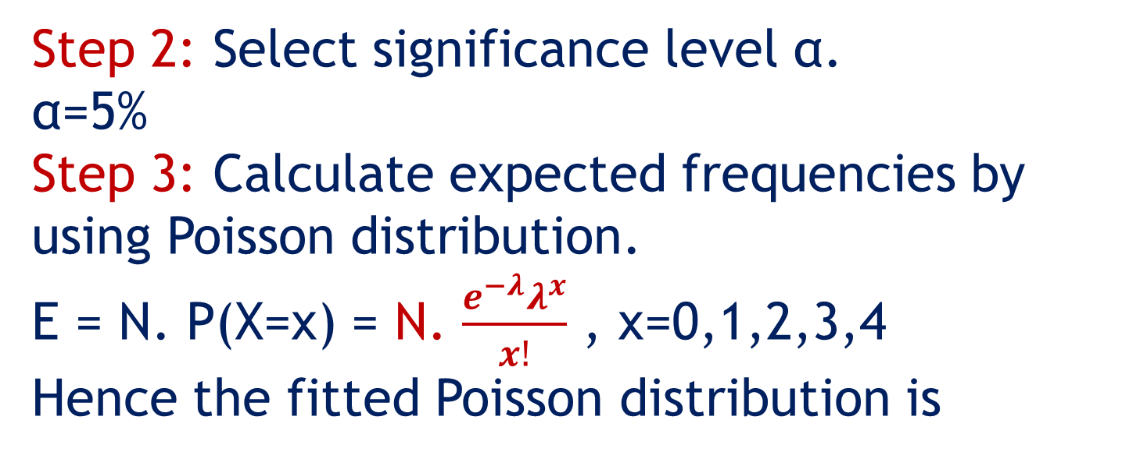
Step 2: Select significance level α. α=5%
Step 3: Calculate expected frequencies by using Poisson distribution.
E = N. P(X=x) = N. $\frac{e^{−λ}λ^{x}}{x!}$ , x=0,1,2,3,4
Hence the fitted Poisson distribution is
X=x | 0 | 1 | 2 | 3 | 4 | Total
Freq(x) | 117.72 | 62.39 | 16.53 | 2.921 | 0.387 | 199.948 ≈200

Slide 8
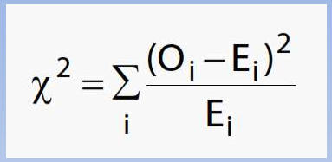
Compute the value of Chi-Square using the following formula:

Slide 9
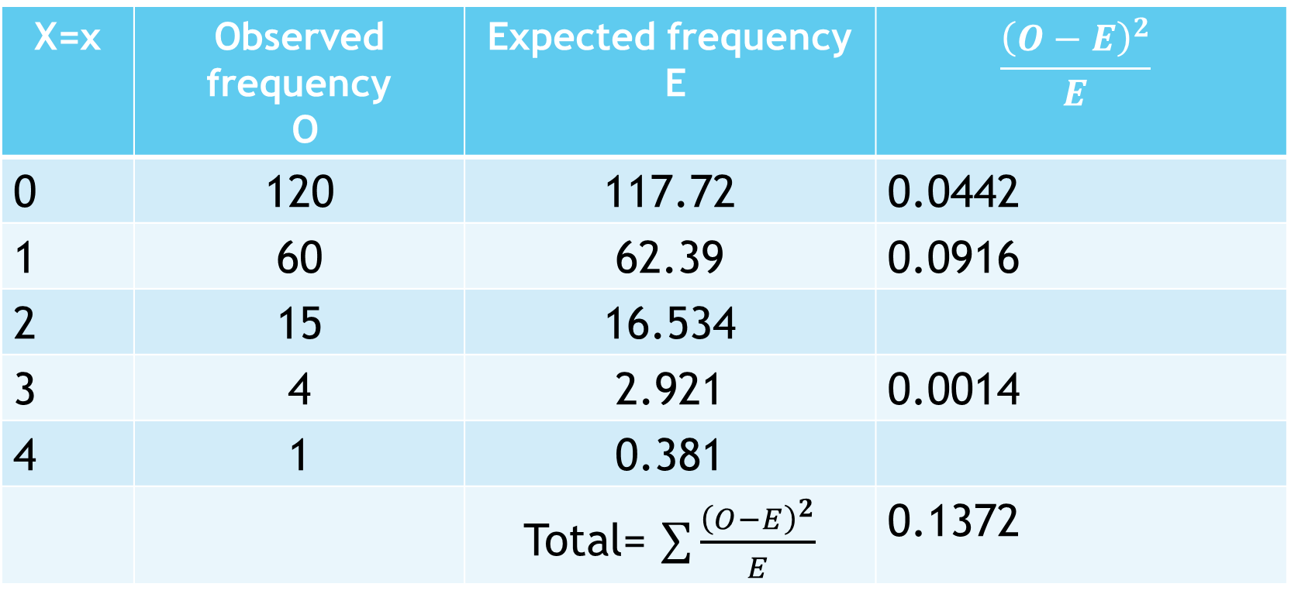
Calculation of chi-square value
X=x | Observed frequency O | Expected frequency E | $$\frac{{\left(O−E\right)}^{2}}{E}$$
0 | 120 | 117.72 | 0.0442
1 | 60 | 62.39 | 0.0916
2 | 15 | 16.534
3 | 4 | 2.921 | 0.0014
4 | 1 | 0.381
 |  | Total= $\sum{\frac{{\left(O−E\right)}^{2}}{E}}$ | 0.1372

Slide 10
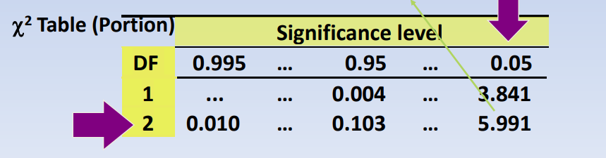
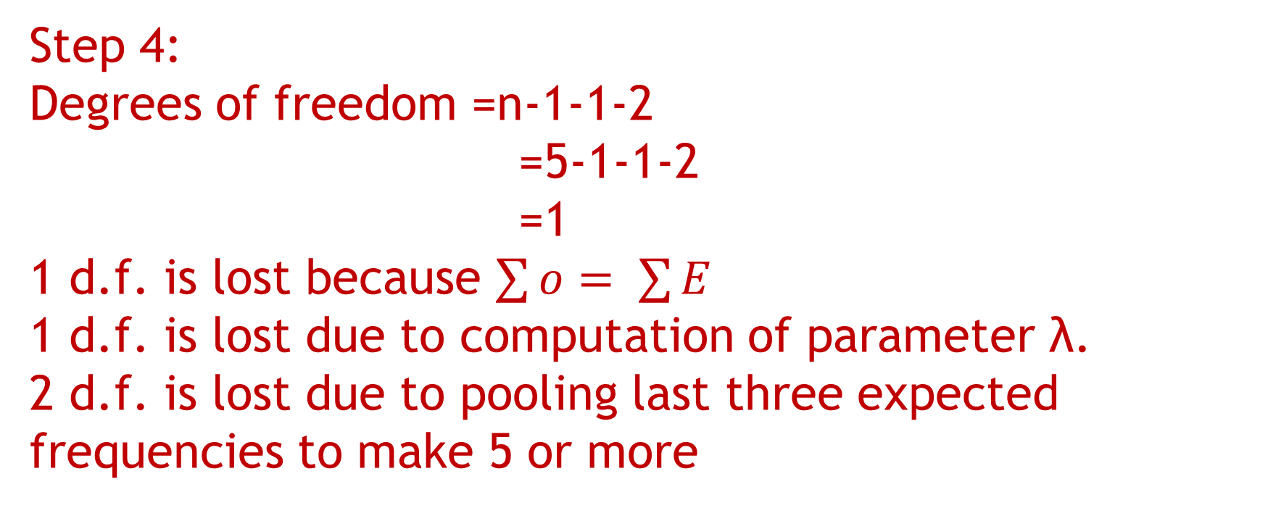
Step 4:
Degrees of freedom =n-1-1-2
=5-1-1-2
=1
1 d.f. is lost because $\sum{o= \sum{E}}$
1 d.f. is lost due to computation of parameter λ.
2 d.f. is lost due to pooling last three expected frequencies to make 5 or more

Slide 11
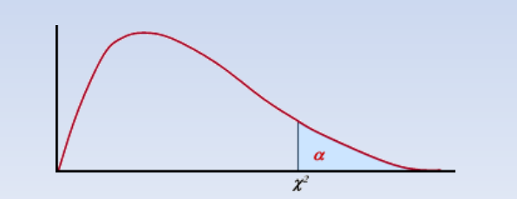
1-α =Acceptance region
Critical region
= 3.841
Critical value

Slide 12
Step 5:
The calculated value of Chi-Square goodness of fit test is compared with the table value.
Here, the calculated value of Chi-Square goodness of fit test is less than the table value, we will accept the null hypothesis and conclude that there is no significant difference between the observed and expected value. So Poisson distribution is a good fit to the given data.

Slide 13
Problem:
A book containing 500 pages was thoroughly checked. The distribution of number of error pages is given below. Using Chi-square test of goodness of fit, verify whether the distribution of errors follow a Poisson distribution
No. of errors (X) | 0 | 1 | 2 | 3 | 4 | 5
No. of pages (f) | 275 | 138 | 75 | 7 | 4 | 1

